Slide 1
Poker
By: Kevin Mortimer, Elise Ducharme and Justin Parker

Slide 2
Goals
-Implement client to server(TCP) game joining and “lobby” creation.
-Implement making a deck of cards and shuffling.
-Implement dealing the cards and rounds of poker: preflop, flop, turn and river betting and folding.

Slide 3
Reasons we used TCP/Persistent connection
-TCP guarantees package delivery which is essential for an online game. If we didn't have guaranteed package delivery then the client would miss parts of the game which would be a huge loss.
- We thought a persistent connection would be best so the client doesn't have to keep connection to the server continuously to make a move.

Slide 4
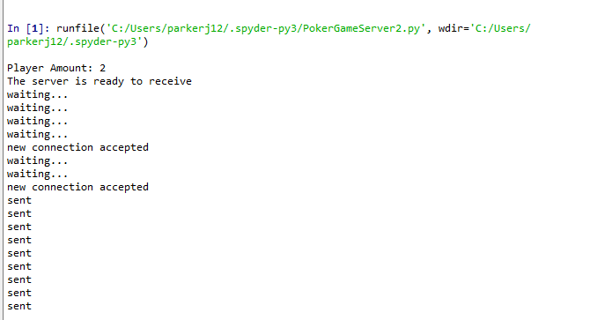
Server after player connection

Slide 5
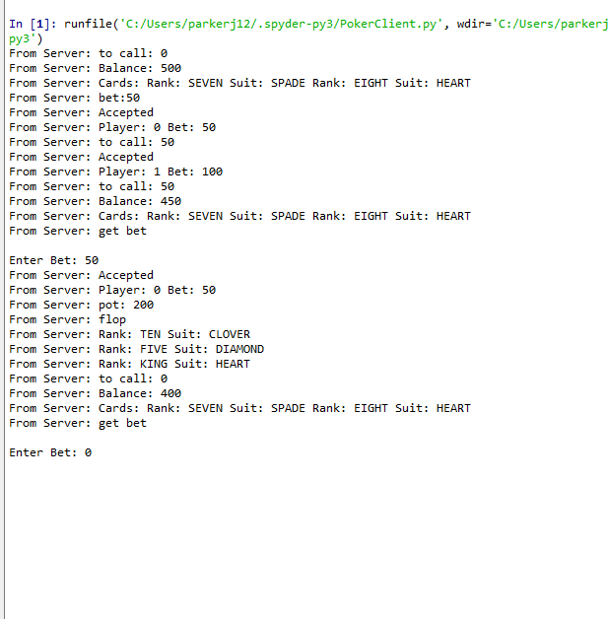
Player 0 after calling player 1’s Big Blind
Player 0: post SB
Player 1: post BB
Player 0: calls
Flop
Player 0 Bets: 0

Slide 6
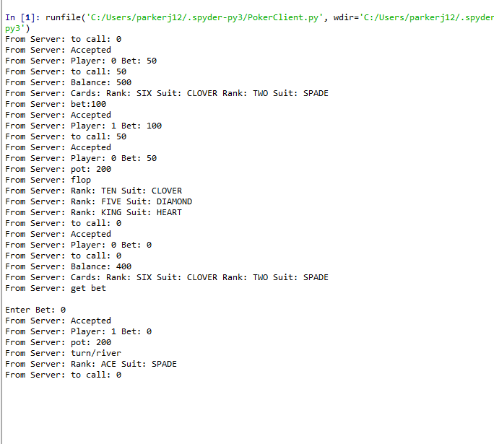
Player 1
Flop
Player 0 bets: 0
Player 1 bets: 0

Slide 7
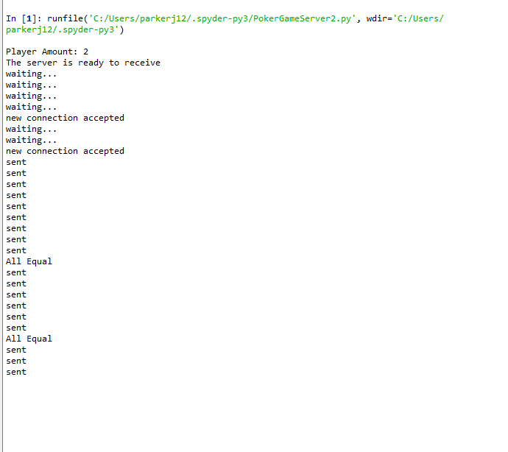
Server:
Detects All Equal
After Preflop and
Flop

Slide 8
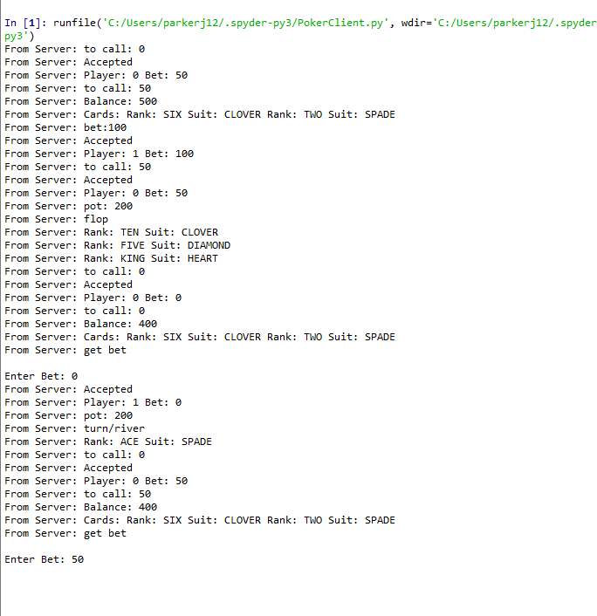
Player 0
Turn comes: ACE of Spade
Player 0 bets: 50

Slide 9
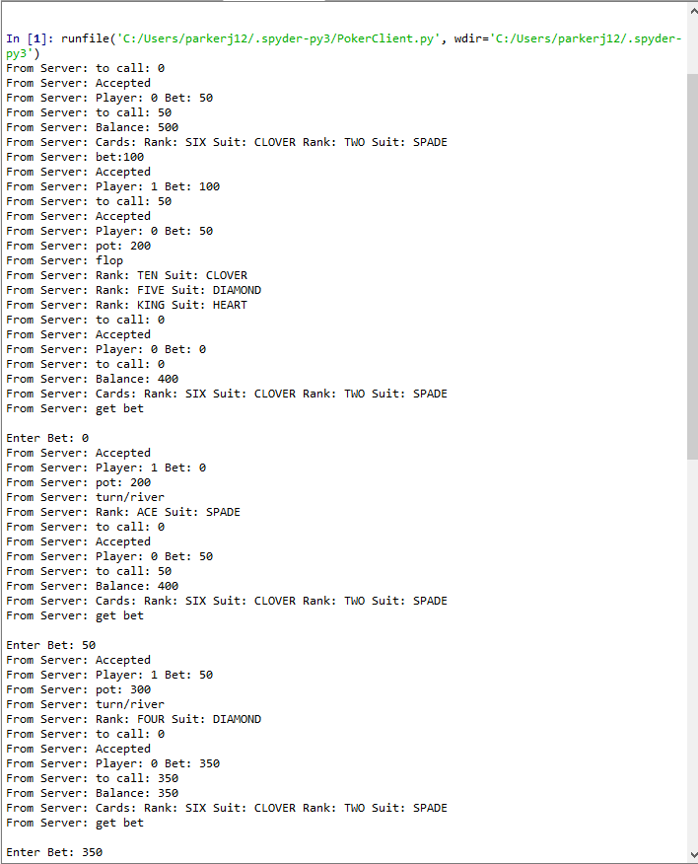
Player 1
Turn comes: ACE of Spade
Player 0 bets: 50
Player 1 bets: 50 to call

Slide 10
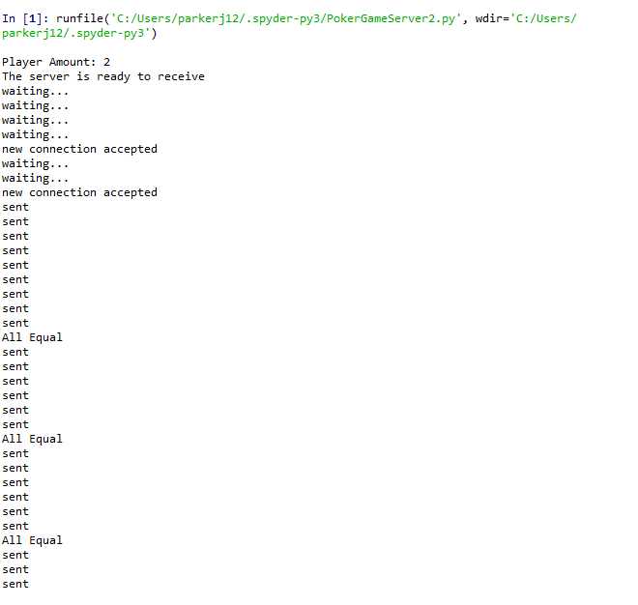
Server
Detects they’re all
equal and round advances
to river

Slide 11
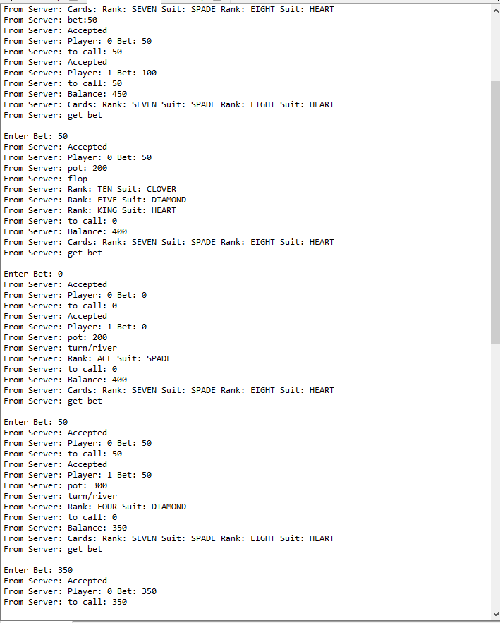
Player 0
River comes: FOUR of Diamond
Player 0 bets: 350 going all in.

Slide 12
Player 1
River comes: FOUR of Diamond
Player 0 bets: 350 going all in.
Player 1 bets: 350 calling and all in.

Slide 13
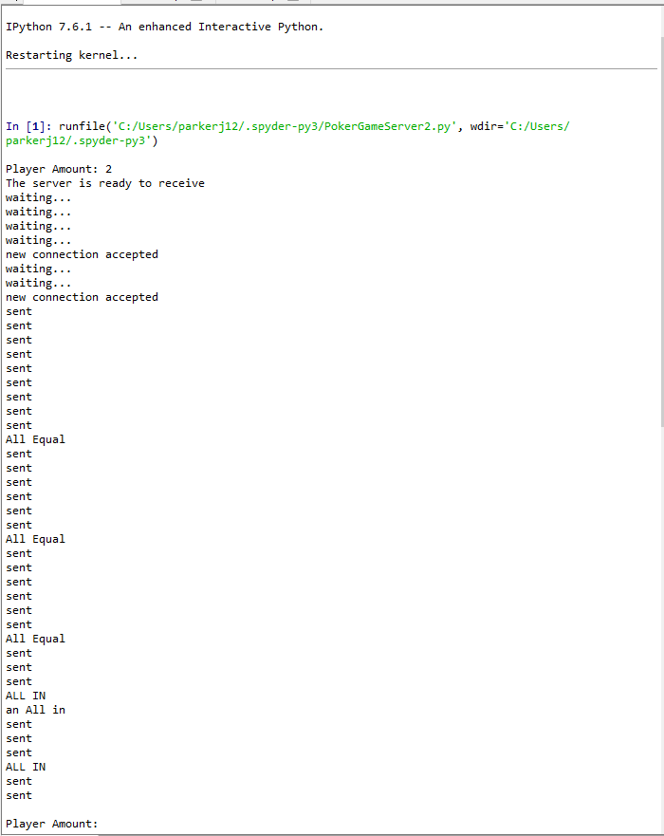
Server
Server Detects an All in and Progresses
round when player calls
after the round the server restarts since
there is only 1 player left who has won
the game.

Slide 14
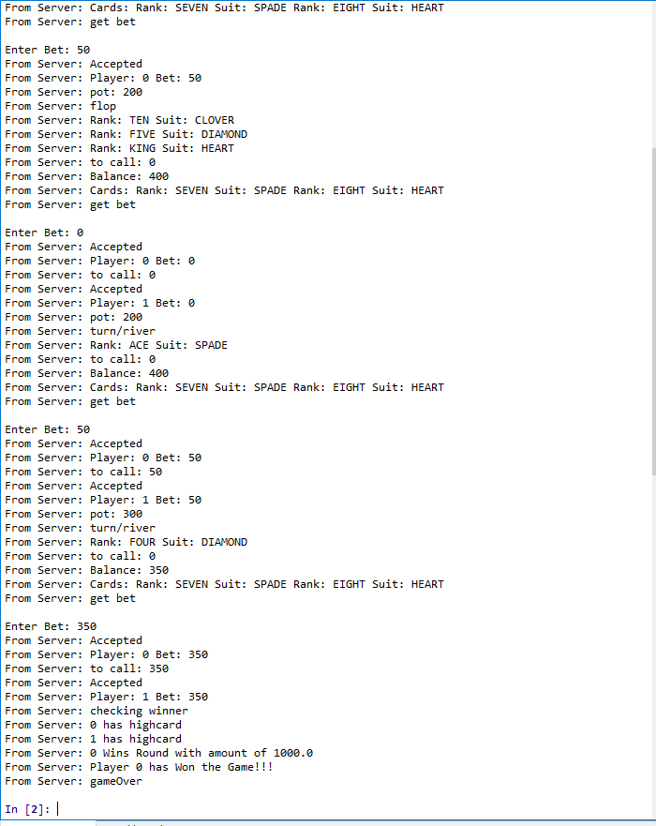
Player 0 and Player 1
Player 0 and Player 1 both only have a
High card but player 0 has the better High
Card Of EIGHT vs Player 1’s SIX player 0 is
Awarded the pot of 1000 and the game is
Now over since player 1 has run out of chips
Leaving Player 0 as the Victor.

